Slide 1
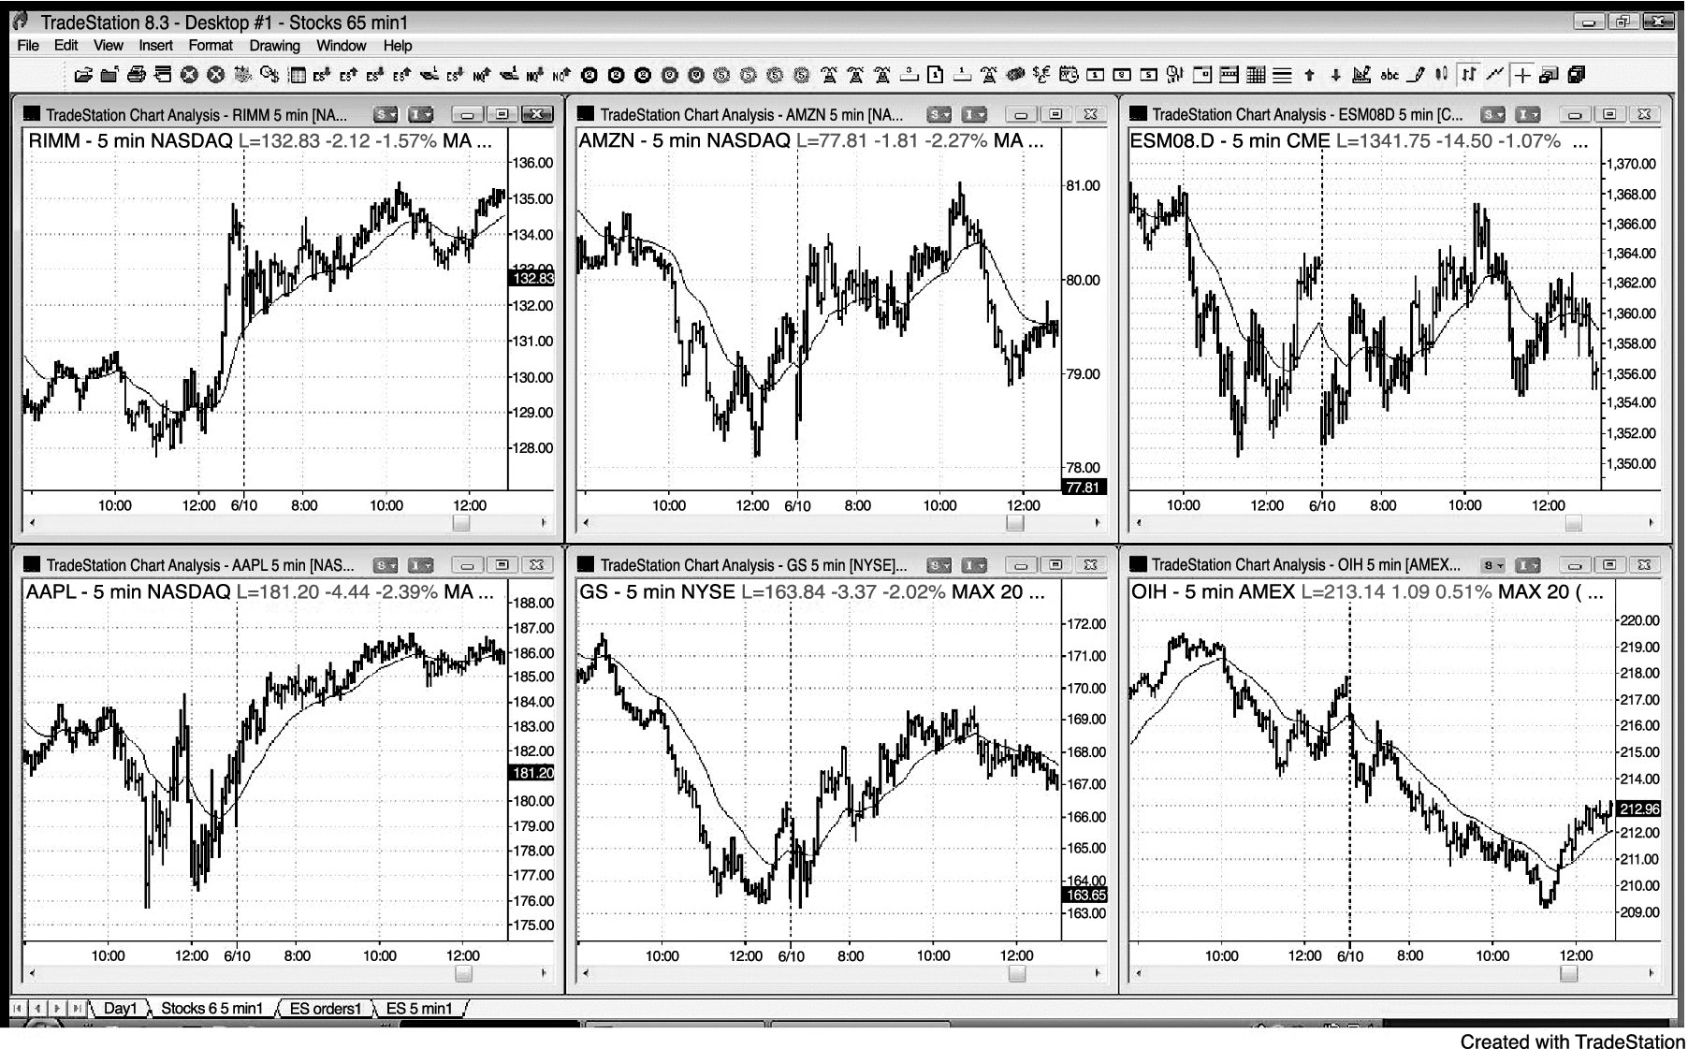
FIGURE 13.1 Swing Trading with Bar Charts

Slide 2
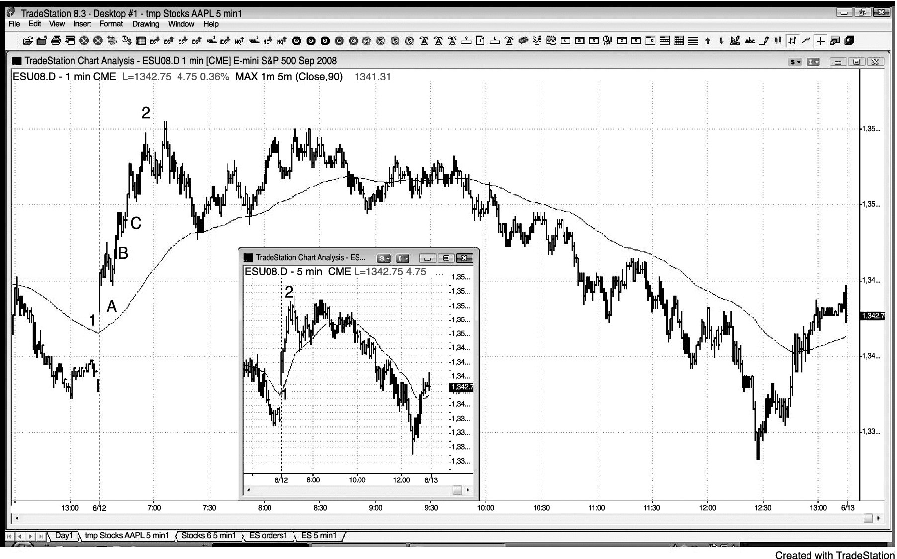
FIGURE 13.2 Pullbacks on 1 Minute Chart

Slide 3
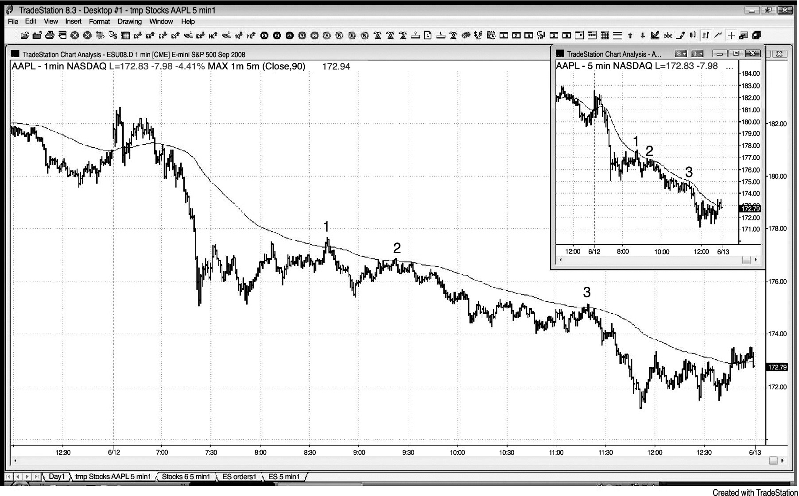
FIGURE 13.3 Moving Average Pullbacks on 1 Minute Chart

Slide 4
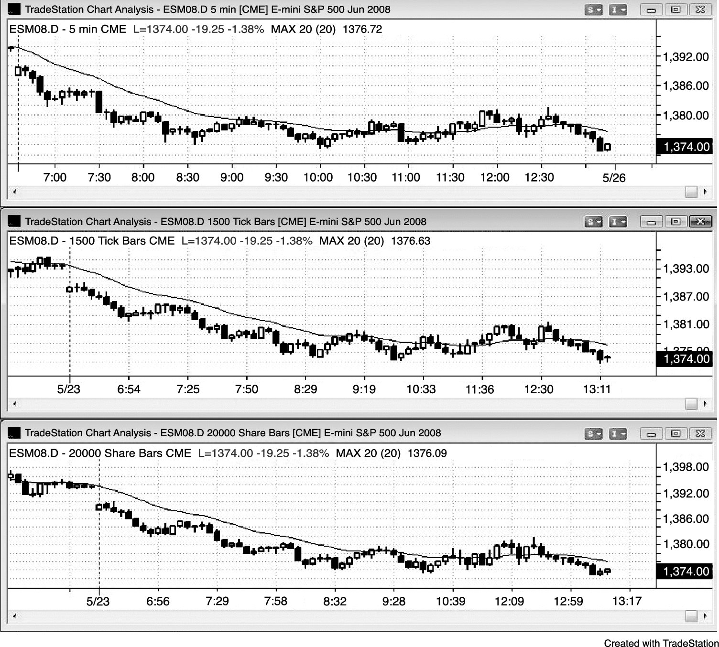
FIGURE 13.4 Volume and Tick Charts Have More Bars in the First Hour or So

Slide 5
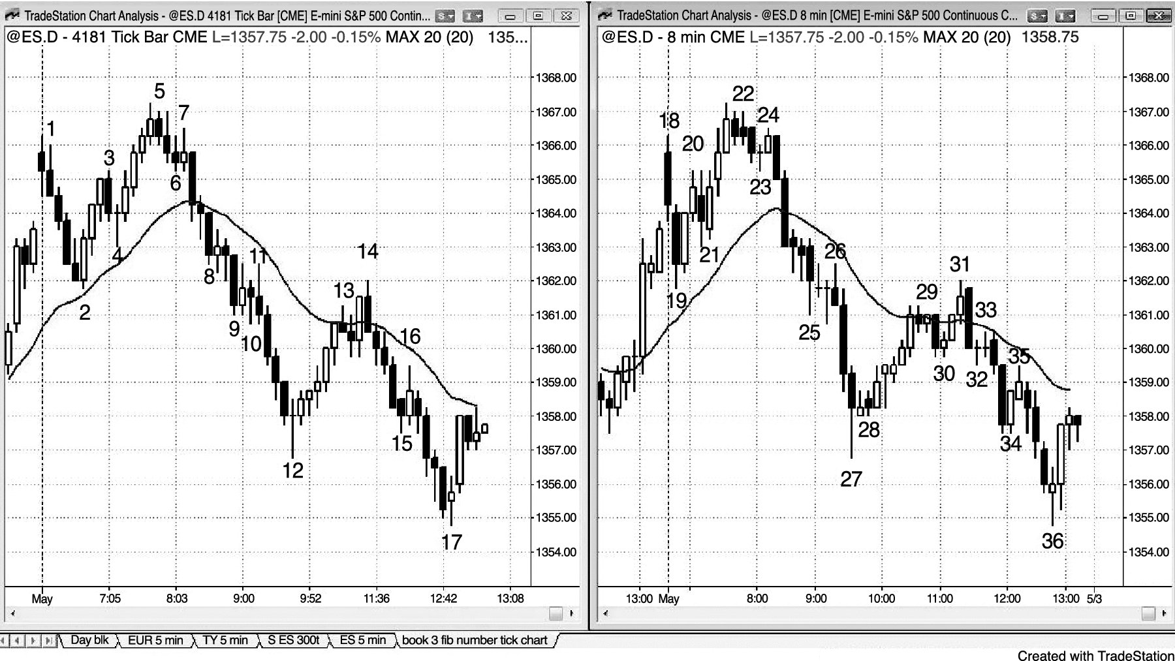
FIGURE 13.5 Price Action Works on Any Time Frame and Any Type of Chart

Slide 6
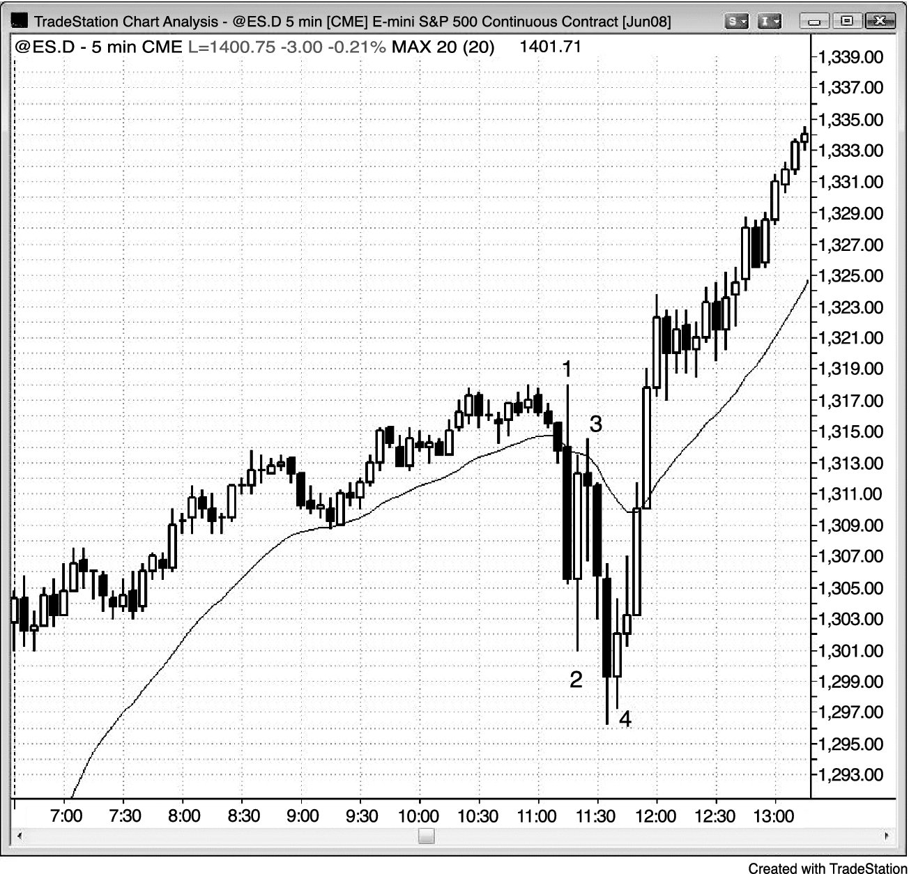
FIGURE 13.6 Big Bars and Reversals during a Report

Slide 7
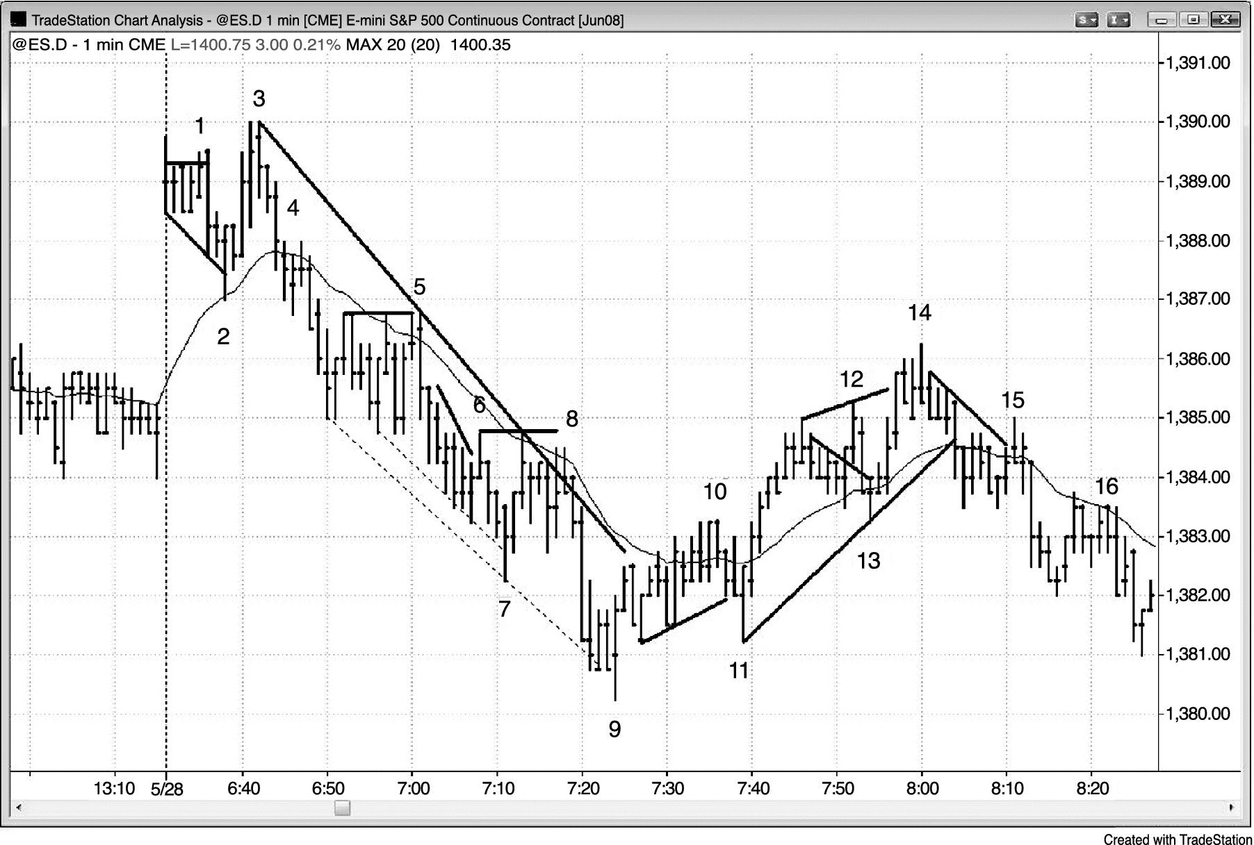
FIGURE 13.7 Scalps in First Hour on 1 Minute Chart

